Slide 1
Improving Unit-Cell Distance Algorithms for Clustering MX images
Herbert J. Bernstein¹, Lawrence C. Andrews²,
Jean Jakoncic³, Alexei Soares³,Nicholas K. Sauter⁴
¹Rochester Institute of Technology, c/o NSLS-II, Brookhaven National Laboratory, Upton, NY, USA
²Ronin Institute, Kirkland, WA, USA
³Brookhaven National Laboratory, Upton, NY, USA
⁴Lawrence Berkeley National Laboratory, Berkeley, CA, USA
Work supported in part by U.S. Department of Energy and U.S. National Institutes of Health

Slide 2
Introduction
A cluster is composed of objects sharing a common characteristic, e.g. the same unit cell.
Cell-based clustering is an established technique in serial crystallography both at xfels and at high brightness synchrotrons.
In some cases the image-by-image distance between cells is the only metric used in defining clusters.
In many cases, cell-based clustering is used to establish clusters of sufficient size to achieve reasonable completeness for each cluster and followed by a transition to reflection-based clustering.

Slide 3
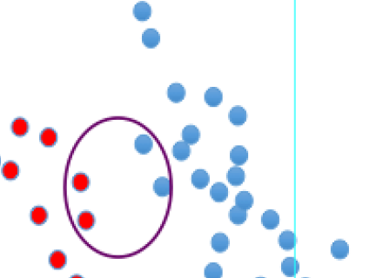
Introduction (cont.)
The difficulty of clustering: This set of points seems to form 4 clearly distinct clusters, but, under some clustering algorithms, the closeness of the 4 points that are circled will cause the two clusters
to which those points belong
to be joined. For our
purposes, it is best to form
clusters that are purely from
a single species than to
merge groups of lattices that
should be distinct.

Slide 4
Introduction (cont.)
The cell-based clustering process must be based on an accurate estimate of the distances among lattices
The clustering technique used must be able to recognize meaningful gaps among clusters.
The most accurate and effective technique for such cell-based clustering in recent years has been the Niggli-reduction-based Andrews-Bernstein NCDist cell distance [Andrews, Bernstein, 2014] used in [Zeldin et al. 2015], but the computational burden is high because of the complexity of the space.
The recently developed Selling-reduction based S6Dist provides a new, more accurate and faster metric

Slide 5
Distances Between Lattices
Many possible characterizations of lattices by cell parameters, e.g. edges and angles, [a, b, c, α, β, γ], metric tensor, etc. and choices of which reduced cell to use to represent each lattice. We look for distances that vary smoothly with small changes in the lattice (perturbation stable), and which satisfy the triangle inequality (metrics).
V⁷ [a, b, c, a*, b*, c*, V] [Andrews, Bernstein, Pellitier 1980]
G⁶ [a², b², c², 2b.c, 2a.c, 2a.b] [Andrews, Bernstein 1988, 2014]
D⁷ [a², b², c², d², (a+d)², (b+d)², (c+d)²] [poster, 2017]
S⁶ [b.c, a.c, a.b, a.d, b.d, c.d] [this talk]

Slide 6
Selling S⁶, a better metric
Based on Delaunay (Delone) reduction
Homogeneous (scalars are dot products of axes)
Only 6 boundaries (versus 15 for G⁶, 7 - 9 for D⁷ )
The coordinates are orthogonal
The basic component of the space is convex
Reduction is simple and FAST
Searches are FAST

Slide 7
Selling Reduction Code
while (true) {
double maxScalar = -DBL_MAX;
for (unsigned long i = 0; i < 6; ++i) {
if (out[i] > maxScalar) {
maxIndex = i;
maxScalar = out[i];
}
}
out = vf[maxIndex](out); // vf is just a bunch of matrices
++m_ReductionCycleCount;
if (S6::CountPositive(out) == 0) return true;
const double negativeSumOfScalars = S6::NegativeSumOfScalars(out);
if (m_ReductionCycleCount > 1000 || negativeSumOfScalars < 0.0 ) return false;
}

Slide 8
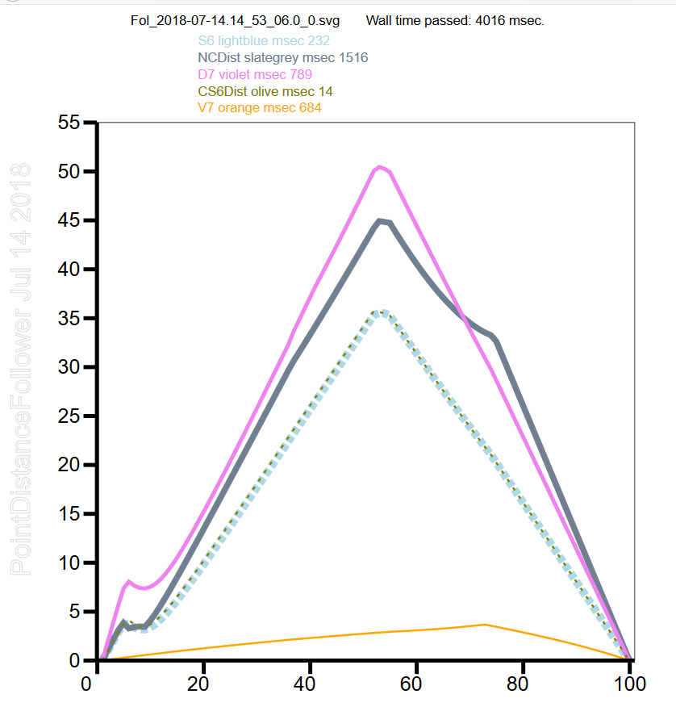
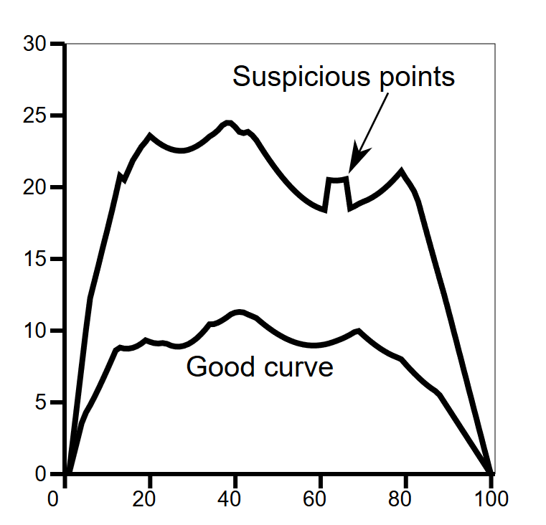
Verifying a Metric

Slide 9
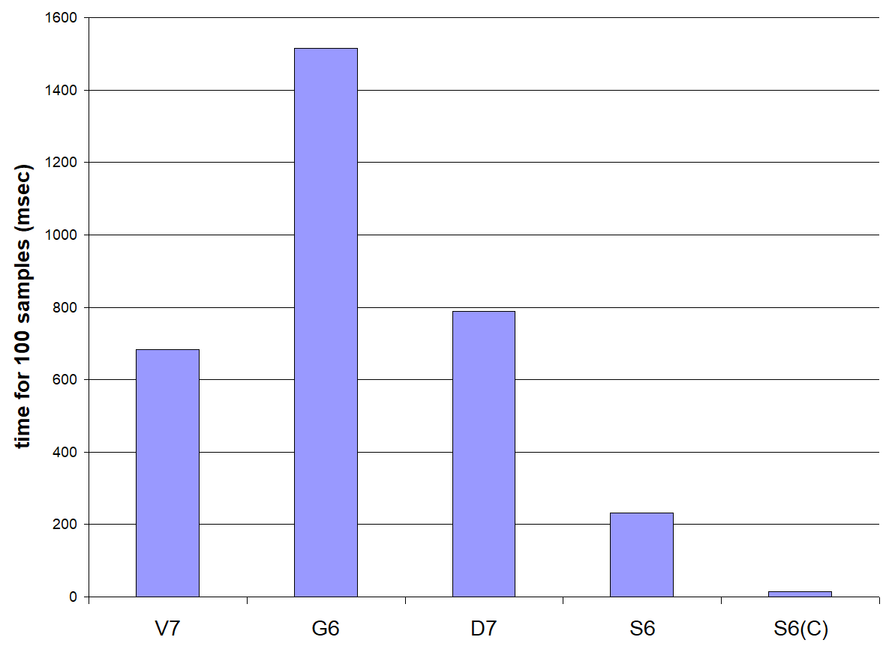
Distance Measures Compared

Slide 10
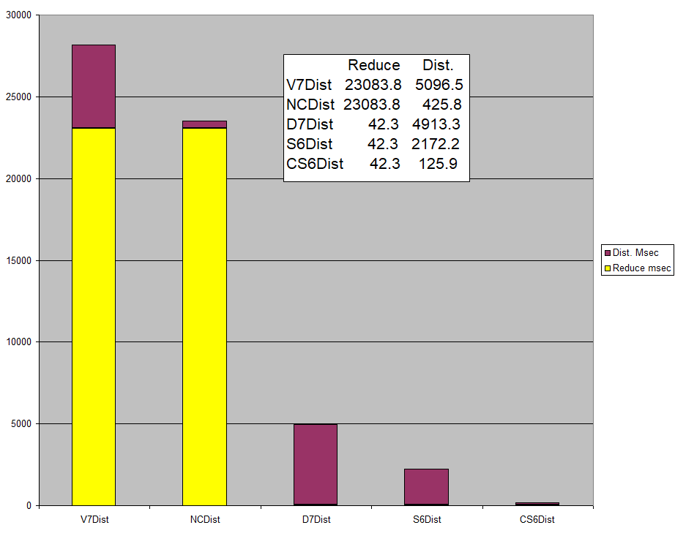
Timing for Distance vs. Reduction

Slide 13
Unit-cell-based clustering is an established technique in serial crystallography, as
performed both at xfels and at high brightness synchrotrons. In some cases the
image-by-image distance between cells is the only metric used in defining
clusters. In many cases, cell-based clustering is used to establish clusters of
sufficient size to achieve reasonable completeness in each cluster, and then a
transition is made to reflection-based clustering. In either case, it is critical to the
success of the overall clustering process that the cell-based clustering be based
on an accurate estimate of the distances among lattices and that the clustering
technique used be able to recognize meaningful gaps among clusters. The most
accurate and effective technique for such cell-based clustering in recent years
has been the Niggli-reduction-based Andrews-Bernstein NCDist cell distance
[Andrews, Bernstein 2014] used in [Zeldin et al. 2015], but the computational
burden is high because of the complexity of the space. The Niggli Cone used in
NCDist has two major components (+++ and ---), is not convex, and has 15
boundaries. Delaunay reduction produces the reduced cell in a single convex
component, with only 9 boundaries, of which only 7 are well-populated,
reducingthe number of cases to be considered by a ratio of 49 in 225. And then
recasting to the earlier unordered Selling formalism of just the inner products
simplifies the space further, leaving only 6 boundaries and reducing the original
number of cases by a ratio of 36 in 225.
At the same time, transitioning from the currently popular Ward hierarchical
clustering to the newer HDBSCAN hierarchical clustering provides further speed
and accuracy improvements.
Work supported in part by NIH (GM117126 and P41GM111244), DOE (DE-
AC02-98CH10886 and E-SC0012704), and Dectris.

